Slide 1

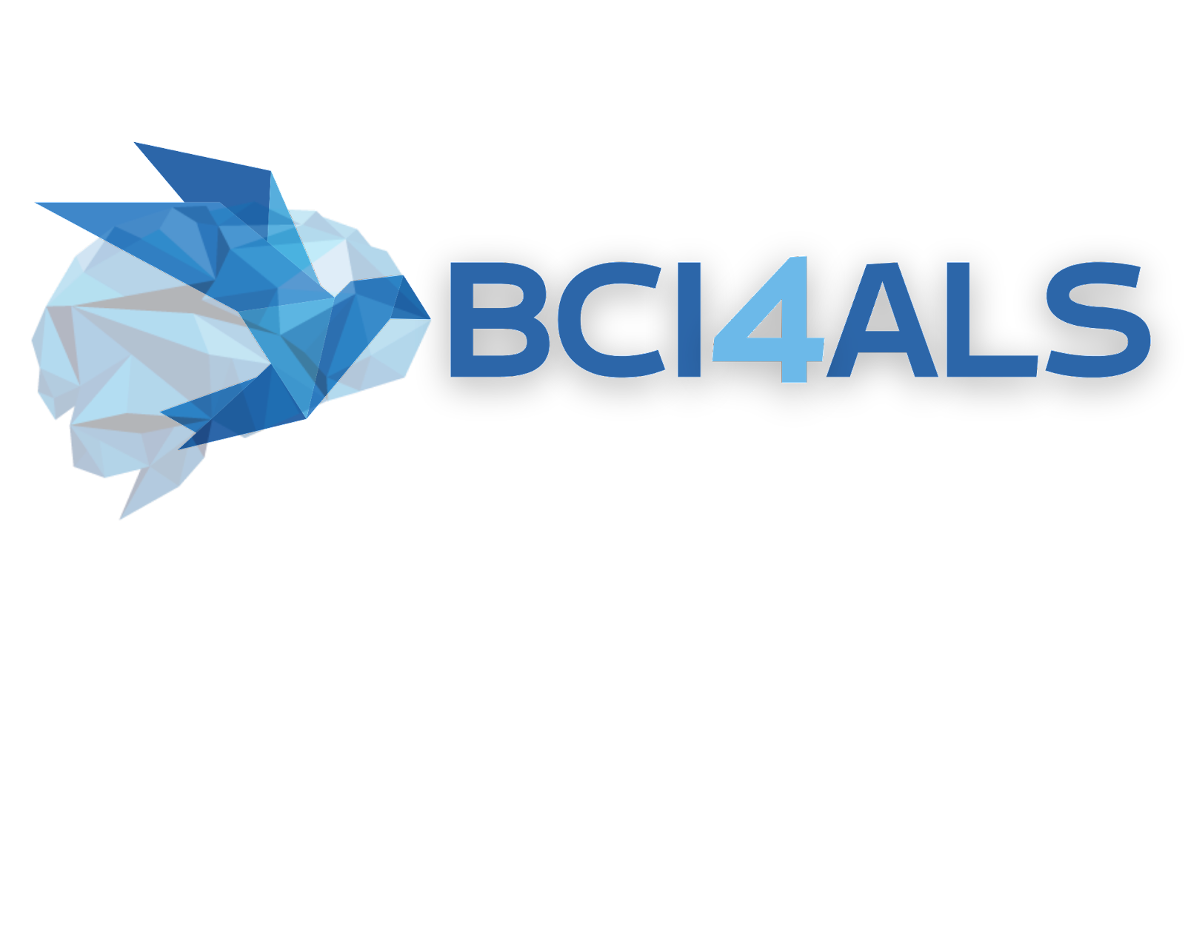
Ophir Almagor and Sagi Furman
Mentor: Eti Gordon

Slide 2
System
MI-based BCI system
Hardware: USBamp by g.tec – 16 channels
Offline and online training
Communication keyboard

Slide 3

The Interface
Creating Motor Imagery interface for communication.
The Interface can be used by patients with closed eyes.
The suggested interface communication speed is slower than eye-tracker interfaces, but can be used at any patient, regardless of the condition.

Slide 4
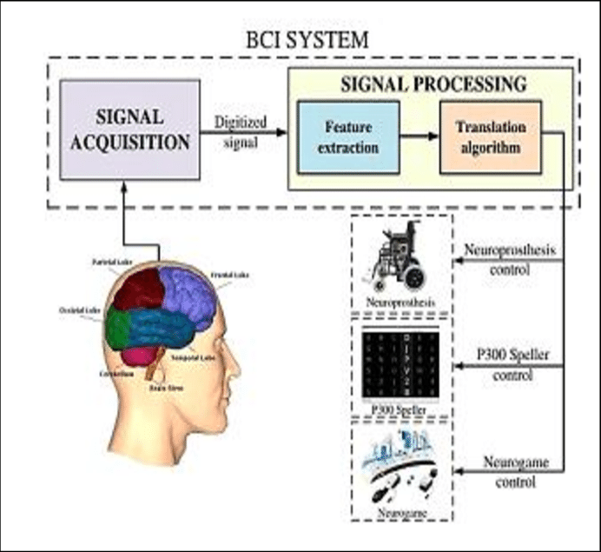
MI-based bci
Signal acquisition – right or left hand movement
Signal processing – data analysis
Various outputs - communication

Slide 5
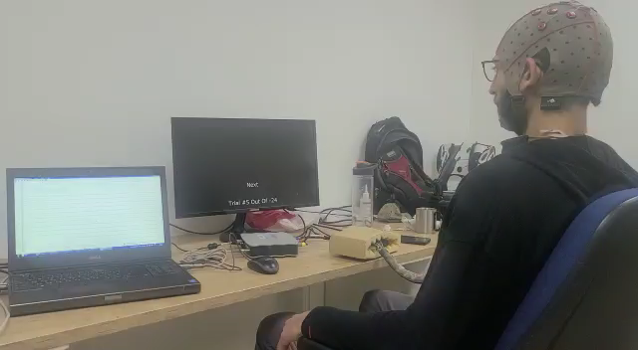
Motor imagery
By imaging an intent for movement, for right \ left arm, or no movement at all.
We can read the cortical motor areas brain activity, to predict the intent of the user.
The interfaces requires training between the AI (Artificial Intelligence) model, and the user.

Slide 6
Data analysis
After each training session, the data is collected and processed. This includes cleaning the data from noise and manipulating the data for better difference between the different brain states.
With the processed data, an AI model is created, and the program will show the score for the model. The higher the score, the better the model will succeed in further predictions.

Slide 7
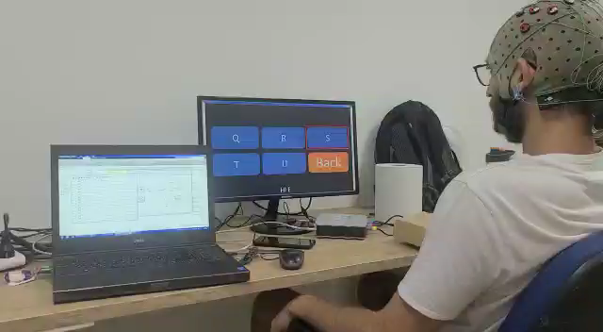
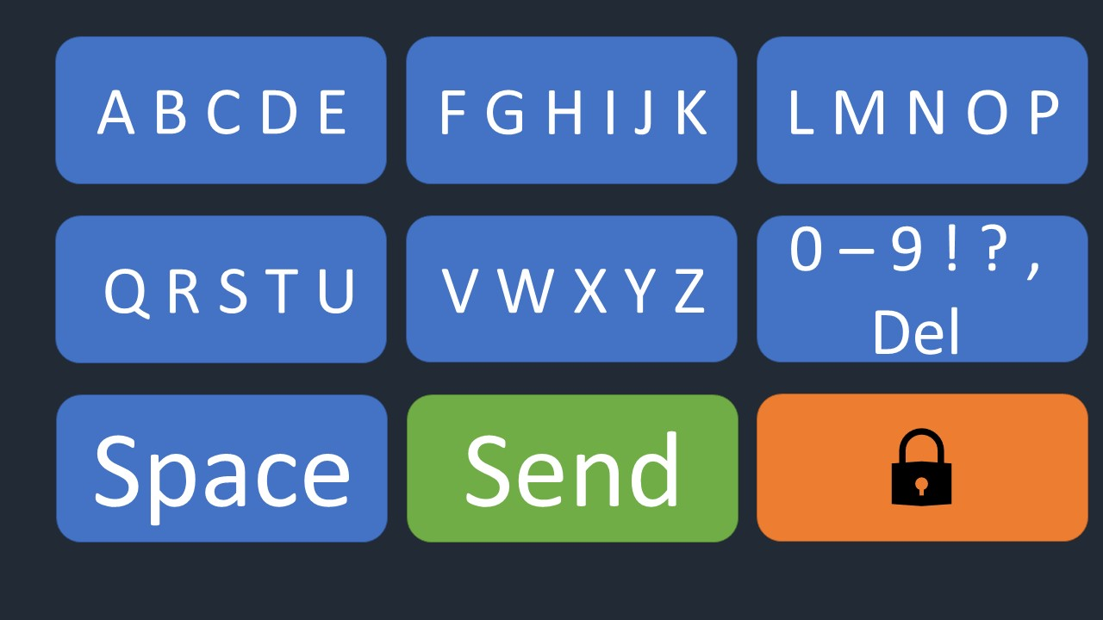
Communication
After a high accuracy model has been achieved, communication interface can be used.
The interface is a keyboard, that with imagining left or right arm movement will be used to choose the letter on the keyboard.

Slide 8
Current system
The best model achieved with the mentor at the moment is around 60%.
Such accuracy is not enough for a reliable communication system.
More data analysis is needed in order to enhance the AI performance.

Slide 9
Thank you for the opportunity to learn and develop with you

